Slide 1

TOPIC- Introduction to computer
COURSE: CCC Concept
CHAPTER: 01 (Introduction to computer)
DAY: 05
NIELIT
Presentation By : Shruti Dubey

Slide 2
Random Access Memory (RAM)
It is also called read-write memory or the main memory or the primary memory.
The programs and data that the CPU requires during the execution of a program are stored in this memory.
It is a volatile memory as the data is lost when the power is turned off.
RAM(Random Access Memory) is a part of computer’s Main Memory which is directly accessible by CPU. RAM is used to Read and Write data into it which is accessed by CPU randomly. RAM is volatile in nature, it means if the power goes off, the stored information is lost. RAM is used to store the data that is currently processed by the CPU. Most of the programs and data that are modifiable are stored in RAM.

Slide 3
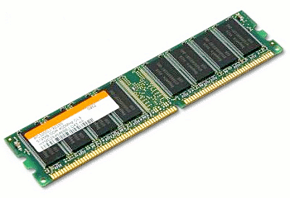
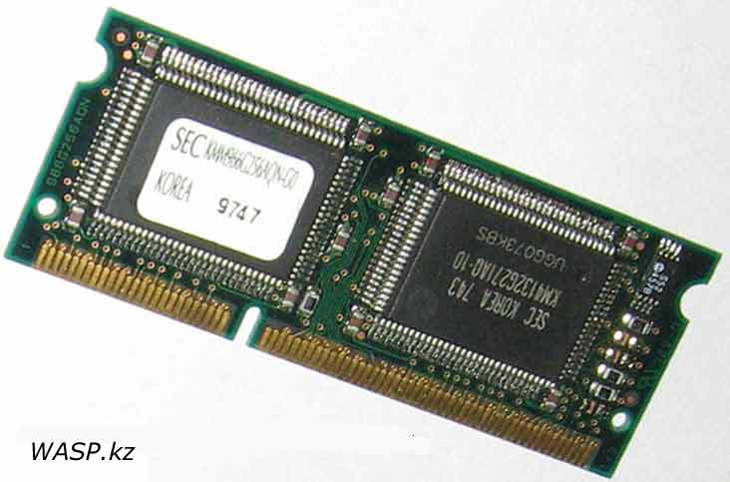
Random Access Memory (RAM)
Integrated RAM chips are available in two form:
1. SRAM(Static RAM)
2. DRAM(Dynamic RAM)

Slide 4
Random Access Memory (RAM)
SRAM memories consist of circuits capable of retaining the stored information as long as the power is applied. That means this type of memory requires constant power. SRAM memories are used to build Cache Memory
DRAM stores the binary information in the form of electric charges applied to capacitors. The stored information on the capacitors tends to lose over a period of time and thus the capacitors must be periodically recharged to retain their usage. The main memory is generally made up of DRAM chips

Slide 5
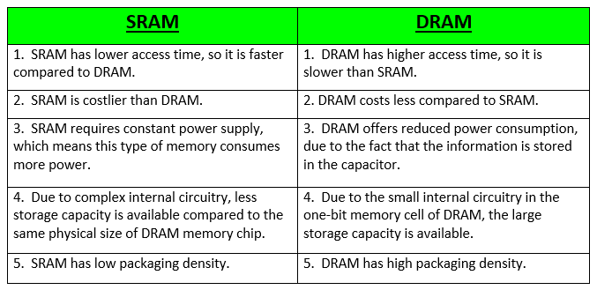
Difference between SRAM and DRAM :

Slide 6
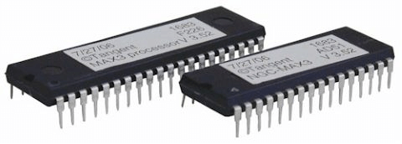
Read-Only Memory (ROM)
Stores crucial information essential to operate the system, like the program essential to boot the computer.
It is not volatile.
Always retains its data.
Used in embedded systems or where the programming needs no change.
Used in calculators and peripheral devices.
ROM is further classified into four types- MROM, PROM, EPROM, and EEPROM.

Slide 7
There are four types of Read Only Memory:
MROM (Masked Read Only Memory): MROM is the oldest type of read-only memory whose program or data is pre-configured by the integrated circuit manufacture at the time of manufacturing. Therefore, a program or instruction stored within the MROM chip cannot be changed by the user.
PROM (Programmable Read Only Memory): It is a type of digital read-only memory, in which the user can write any type of information or program only once. It means it is the empty PROM chip in which the user can write the desired content or program only once using the special PROM programmer or PROM burner device; after that, the data or instruction cannot be changed or erased.
EPROM (Erasable and Programmable Read Only Memory): It is the type of read only memory in which stored data can be erased and re-programmed only once in the EPROM memory. It is a non-volatile memory chip that holds data when there is no power supply and can also store data for a minimum of 10 to 20 years. In EPROM, if we want to erase any stored data and re-programmed it, first, we need to pass the ultraviolet light for 40 minutes to erase the data; after that, the data is re-created in EPROM.
EEPROM (Electrically Erasable and Programmable Read Only Memory): The EEROM is an electrically erasable and programmable read only memory used to erase stored data using a high voltage electrical charge and re-programmed it. It is also a non-volatile memory whose data cannot be erased or lost; even the power is turned off. In EEPROM, the stored data can be erased and reprogrammed up to 10 thousand times, and the data erase one byte at a time.

Slide 8
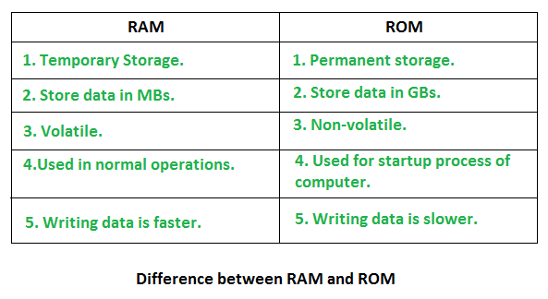
Computer Memory

Slide 9
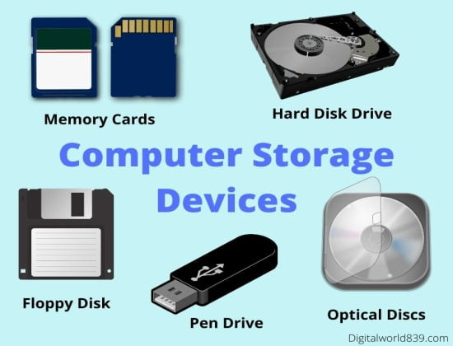
Secondary Memory
The secondary storage devices which are built into the computer or connected to the computer are known as a secondary memory of the computer. It is also known as external memory or auxiliary storage.
The secondary memory is accessed indirectly via input/output operations. It is non-volatile, so permanently stores the data even when the computer is turned off or until this data is overwritten or deleted. The CPU can't directly access the secondary memory. First, the secondary memory data is transferred to primary memory then the CPU can access it.
Some of the secondary memory or storage devices are described below:

Slide 10
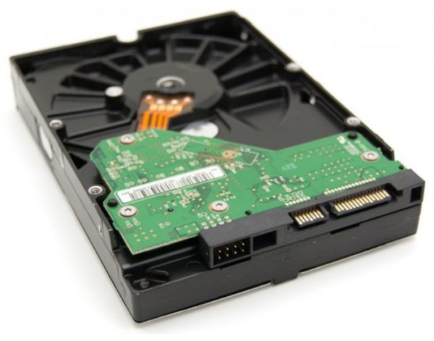
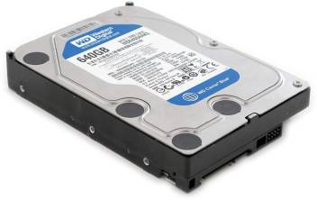
Hard Disk:
It is a rigid magnetic disc that is used to store data. It permanently stores data and is located within a drive unit. The hard disk is also known as a hard drive. It is a rigid magnetic disc that stores data permanently, as it is a non-volatile storage device. The hard disk is located within a drive unit on the computer's motherboard and comprises one or more platters packed in an air-sealed casing. The data is written on the platters by moving a magnetic head over the platters as they spin. The data stored on a computer's hard drive generally includes the operating system, installed software, and the user's files and programs, including pictures, music, videos, text documents, etc.

Slide 11
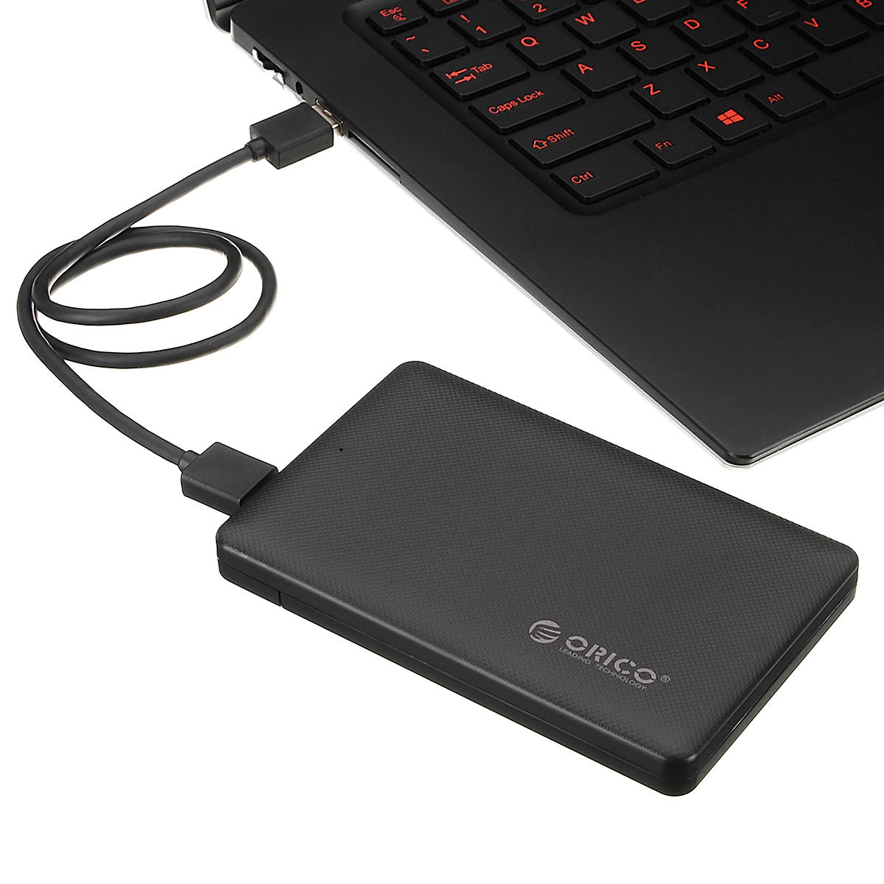
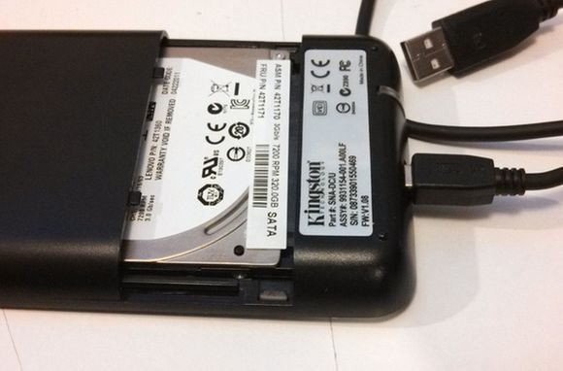
External Hard Disk

Slide 12
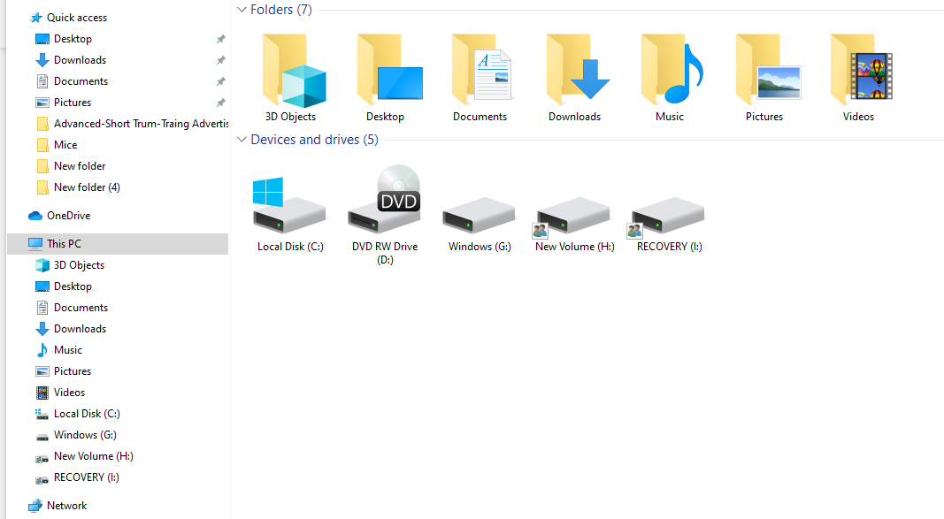
Hard Disk partition details :

Slide 13
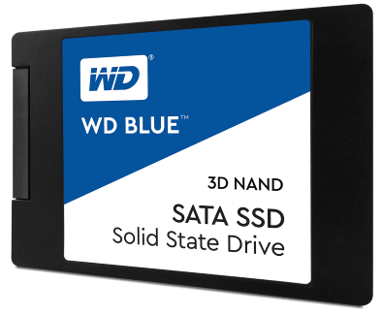
Solid-state Drive:
SSD (Solid State Drive) is also a non-volatile storage medium that is used to hold and access data. Unlike a hard drive, it does not have moving components, so it offers many advantages over SSD, such as faster access time, noiseless operation, less power consumption, and more.
As the cost of SSD has come down, it has become an ideal replacement for a standard hard drive in desktop and laptop computers. It is also suitable for notebooks, and tablets that don't require lots of storage.

Slide 14

Pen drive:
Pen drive is a compact secondary storage device. It is also known as a USB flash drive, thumb drive or a jump drive. It connects to a computer via a USB port. It is commonly used to store and transfer data between computers. For example, you can write a report using a computer and then copy or transfer it in the pen drive. Later, you can connect this pen drive to a computer to see or edit your report. You can also store your important documents and pictures, music, videos in the pen drive and keep it at a safe place.
Pen drive does not have movable parts; it comprises an integrated circuit memory chip that stores the data. This chip is housed inside a plastic or aluminium casing. The data storage capacity of the pen drive generally ranges from 2 GB to 128 GB. Furthermore, it is a plug and play device as you don't need additional drives, software, or hardware to use it.

Slide 15
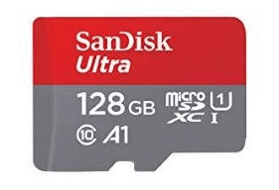
SD Card:
SD Card stands for Secure Digital Card. It is most often used in portable and mobile devices such as smartphones and digital cameras. You can remove it from your device and see the things stored in it using a computer with a card reader.
There are many memory chips inside the SD card that store the data; it does not have moving parts. SD cards are not created equal, so they may differ from each other in terms of speed, physical sizes, and capacity. For example, standard SD cards, mini SD cards, and micro SD cards.

Slide 16
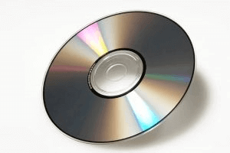
Compact Disk (CD):
Compact Disk is a portable secondary storage device in the shape of a round medium disk. It is made of polycarbonate plastic. The concept of CD was co-developed by Philips and Sony in 1982. The first CD was created on 17 August 1982 at the workshop of Philips in Germany.
In the beginning, it was used for storing and playing sound recordings, later it was used for various purposes such as for storing documents, audio files, videos, and other data like software programs in a CD.

Slide 17
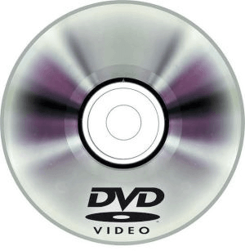
DVD:
DVD is short for digital versatile disc or digital video disc. It is a type of optical media used for storing optical data. Although it has the same size as a CD, its storage capacity is much more than a CD. So, it is widely used for storing and viewing movies and to distribute software programs as they are too large to fit on a CD. DVD was co-developed by Sony, Panasonic, Philips, and Toshiba in 1995.

Slide 18
Floppy Disk
A floppy disk, also known as a floppy, diskette, or simply disk, is a type of disk storage composed of a disk of thin and flexible magnetic storage medium, sealed in a rectangular plastic enclosure lined with fabric that removes dust particles. Floppy disks are read and written by a floppy disk drive (FDD).

Slide 19
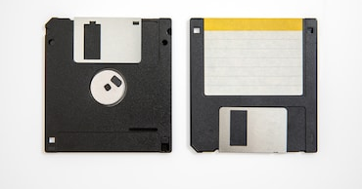
Floppy Disk
The first 8-inch floppy disk had a storage capacity of about 80 kilobytes. By 1986, IBM introduced the 3-1/2 inch floppy disk with 1.44 megabytes of storage space.

Slide 20
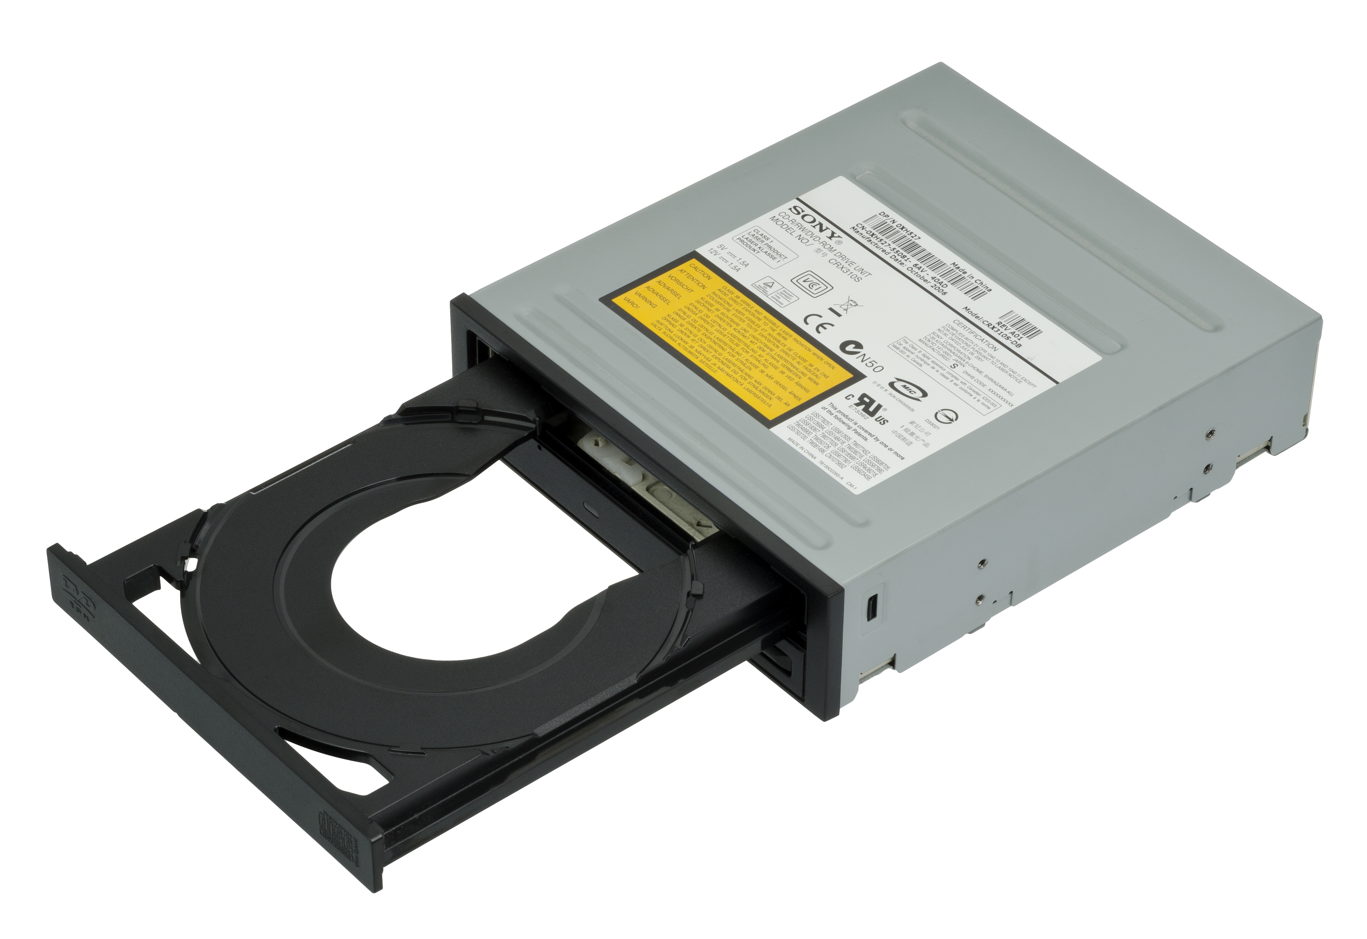
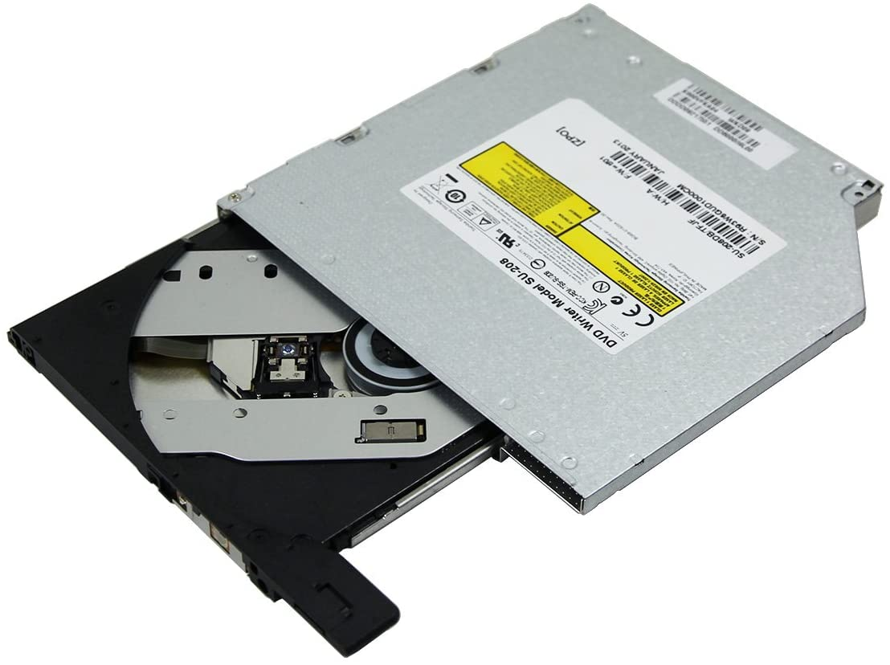
Secondary Memory
Optical Disk (CD)

Slide 21
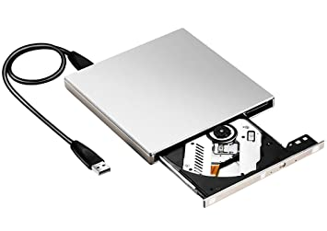
Secondary Memory
USB Optical Disk (CD)

Slide 22
Memory Units
Memory units are used to measure and represent data. Some of the commonly used memory units are:
Bit: The computer memory units start from bit. A bit is the smallest memory unit to measure data stored in main memory and storage devices. A bit can have only one binary value out of 0 and 1.
Byte: It is the fundamental unit to measure data. It contains 8 bits or is equal to 8 bits. Thus a byte can represent 2*8 or 256 values.
Kilobyte: A kilobyte contains 1024 bytes.
Megabyte: A megabyte contains 1024 kilobytes.
Gigabyte: A gigabyte contains 1024 megabyte.
Terabyte: A terabyte contains 1024 gigabytes.

Slide 23
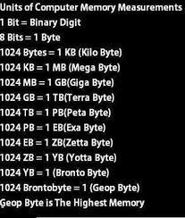
Memory Measurements

Slide 24
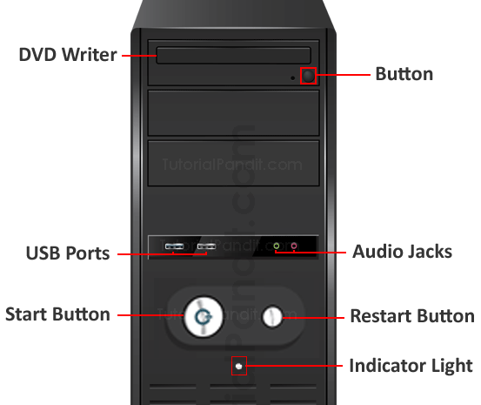
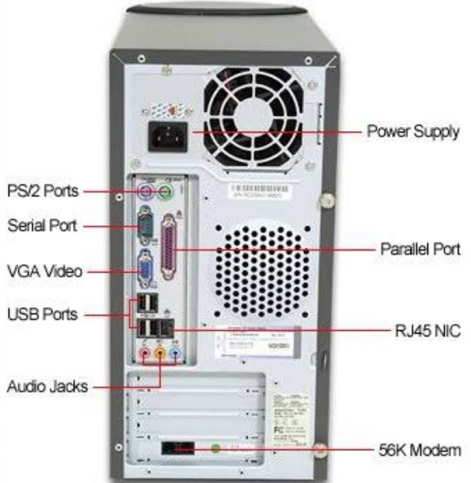
Computer System
Power Switch
Reset Button
CD/DVD Rom Drive
Indicate Light
Power Supply Socket
Keyboard Socket
Mouse Socket
Parallel Port
VGA Port (Video Graphics Array)
USB Port (Universal Serial Bus)
Mic & Speaker Jack slot
Network Slot
IEEE Port (Institute of Electrical & Electronics Engineers high speed serial bus standard)
Fan
Motherboard
Display Adapter Card/Graphic card
Expansion Slots
HDMI (High Definition Media Interface)

Slide 25
Thank You
NIELIT
Presentation By : Shruti Dubey

